Slide 1

Nuget What on earth is it?
Gary Ewan Park
gep13@gep13.co.uk
Twitter: @gep13
Blog: http://www.gep13.co.uk/blog

Slide 2
Agenda
What is Nuget?
Add Elmah to Project
Add Nhibernate (including dependencies) to Project
How to enable Nuget for “No-Commit” strategy
Examine the contents of a Nuget package
Package an existing DLL into a Nuget bundle

Slide 3
Source Code
http://gep13.me/NugetDemos
Notes:
Questions – feel free to ask them at any point, just throw up your hand, or if I don’t see you, feel free to shout at me.
Explain what I have on my machine, i.e. all code in Local Git Repo, Git Extensions in Visual Studio, TeamCity, local Nuget Repo for a couple packages
Make sure to explain that the intention of the talk is to show how, out of the box, StyleCop can appear to be slightly “jarring”. However, there are processes and tooling that you can add/implemented that can make things easier.

Slide 4
What is Nuget?

Slide 5
A Definition…
“NuGet is a free, open source developer focused package management system for the .NET platform intent on simplifying the process of incorporating third party libraries into a .NET application during development. NuGet is a member of the ASP.NET Gallery in the Outercurve Foundation” *
Reference
http://nuget.codeplex.com/
Notes:
Ask who is currently using StyleCop
Ask who is currently using FxCop – Code Analysis
Coding Standard ARE NOT the personal preference of the most senior person on the team!

Slide 6
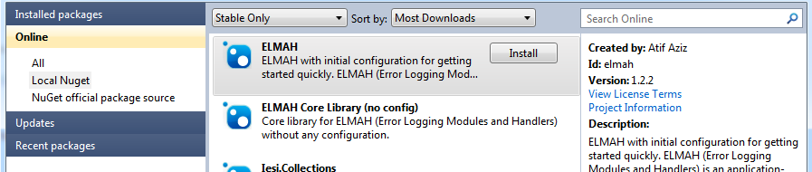

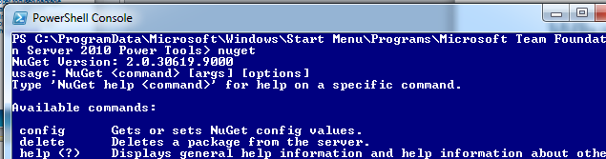
What does that mean?
Nuget comes in three flavours
Visual Studio plugin called Package Manager
Visual Studio command line add-in call Package Manager Console
Standalone command line executable
Notes:
The rules are classified into the following categories:
- Documentation
- Layout
- Maintainability
- Naming
- Ordering
- Readability
- Spacing
StyleCop includes both GUI and command line versions of the tool. It is possible to create new rules to be used.
StyleCop was re-released as an open source project in April of 2010, at http://stylecop.codeplex.com.
Originally used internally within Microsoft, and later released to the public.

Slide 7
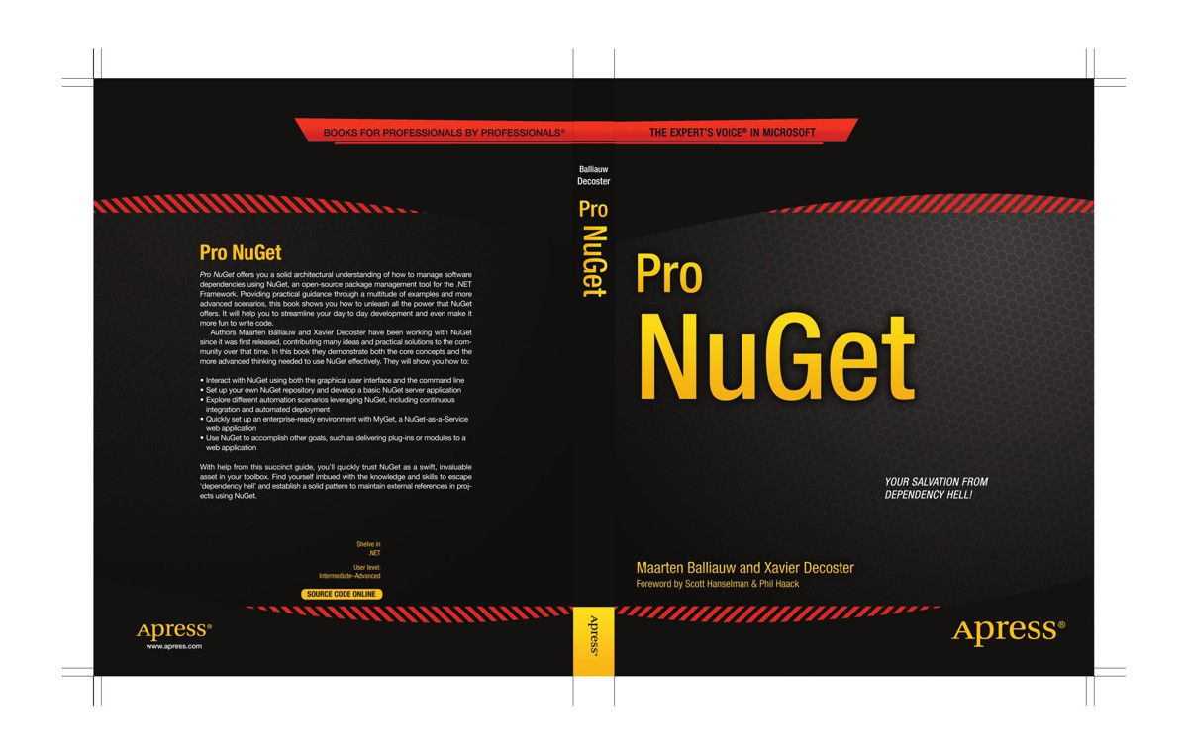
Recommended Book

Slide 8
Demo Time
No more slides! Woo hoo! ☺

Slide 9
Questions?
Feel free to email me any additional questions at
gep13@gep13.co.uk

